Slide 1



K.RAMAKRISHNAN COLLEGE OF ENGINEERING
(AUTONOMOUS), TRICHY
AMB1301-DATA VISUALIZATION & ANALYTICS
Department of CSE(Artificial Intelligence And Machine Learning)
Academic Year: 2025-2026 (Odd Semester)
TITLE :IPL ANALYSIS AND DASHBOARD CREATION
NAME : AKSHALA T
REG. NO.: 8115U23AM006
YEAR : III
SEMESTER : V

Slide 2
OVERVIEW
Problem statement
Tools used
System Archietecture
Modules
Visualization(Output)
Conclusion
Future scope
References

Slide 3
PROBLEM STATEMENT
Huge amount of IPL match data generated every season.
Manual analysis is time-consuming, inconsistent, and error-prone.
Difficulty in identifying patterns such as team performance, toss impact, venue influence.
Need for a predictive tool to estimate match outcomes based on historical trends.
Requirement for a simple interface where users can view insights visually.

Slide 4
TOOLS USED
Python – data processing & analytics
Pandas, NumPy – data cleaning and manipulation
Matplotlib, Seaborn – visualizations
Scikit-Learn (Random Forest) – prediction model
Streamlit – interactive dashboard
VS Code – development environment
CSV Datasets (Kaggle IPL Data)

Slide 5
SYSTEM ARCHITECTURE
DATA COLLECTION LAYER
Importing IPL CSV dataset
DATA PREPROCESSING LAYER
Cleaning, encoding, feature extraction
VISUALIZATION LAYER
Generating charts & heatmaps
ML MODEL LAYER
Training Random Forest on historical data
PREDICTION LAYER
Producing winner predictions
DASHBOARD LAYER
Streamlit UI for interactive user access

Slide 6
MODULES
Data Preprocessing Module : Cleaning, handling missing values, encoding categories
Visualization & Statistical Analysis Module :Graphs: matches per season, team wins, toss trends, heatmaps
Machine Learning Prediction Module: Random Forest training, accuracy evaluation, result prediction

Slide 7
MODULES
Streamlit Dashboard Module :User interface, charts, interactive match prediction
Model Evaluation Module :Train-test split, accuracy, confusion matrix, optimization

Slide 8
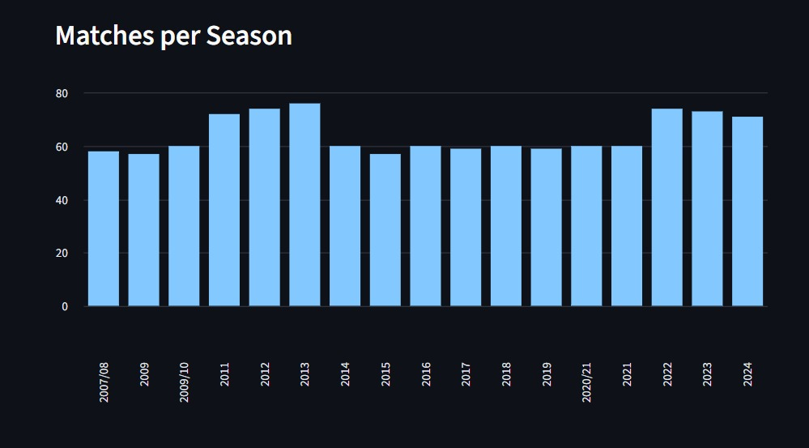
VISUALISATION
Matches per season (bar chart)

Slide 9
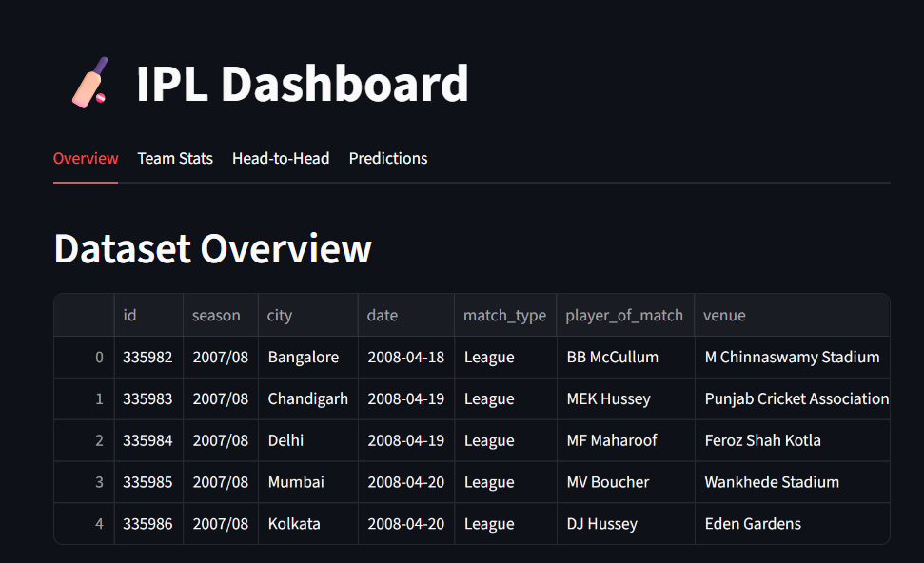
VISUALISATION
Dataset overview

Slide 10
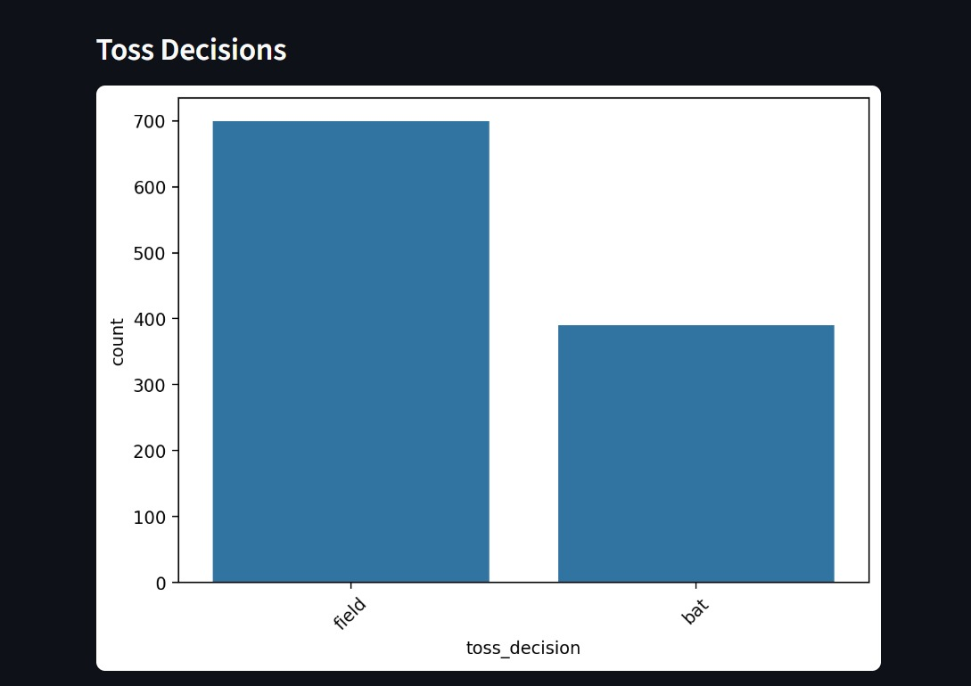
VISUALISATION
Toss decisions (bar chart)

Slide 11
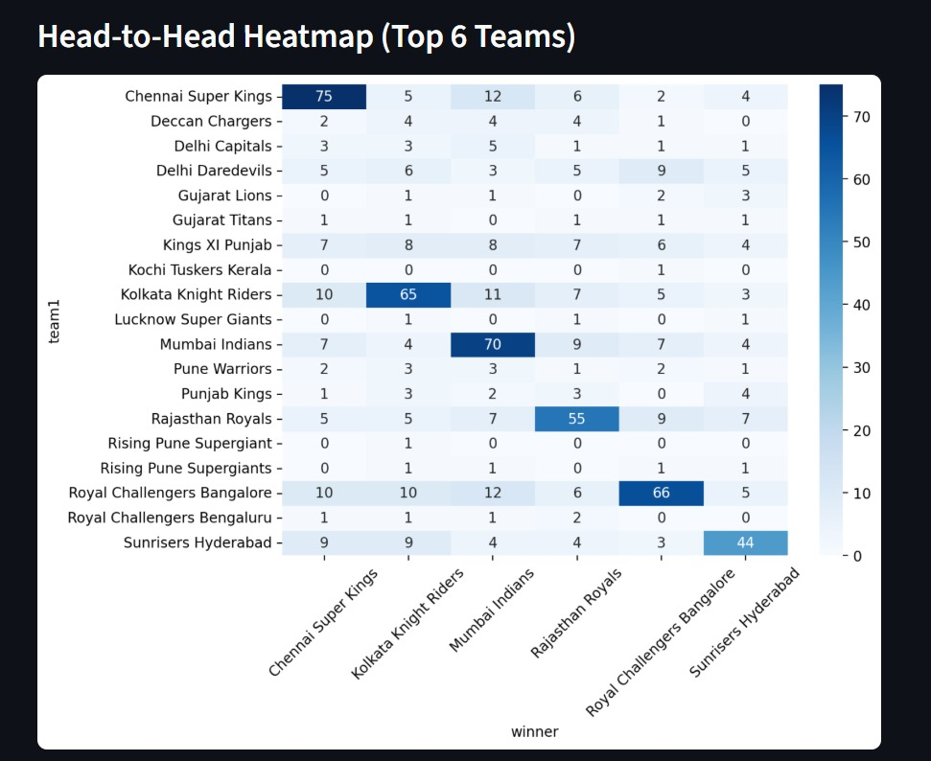
VISUALISATION
Head-to-head heatmap

Slide 12
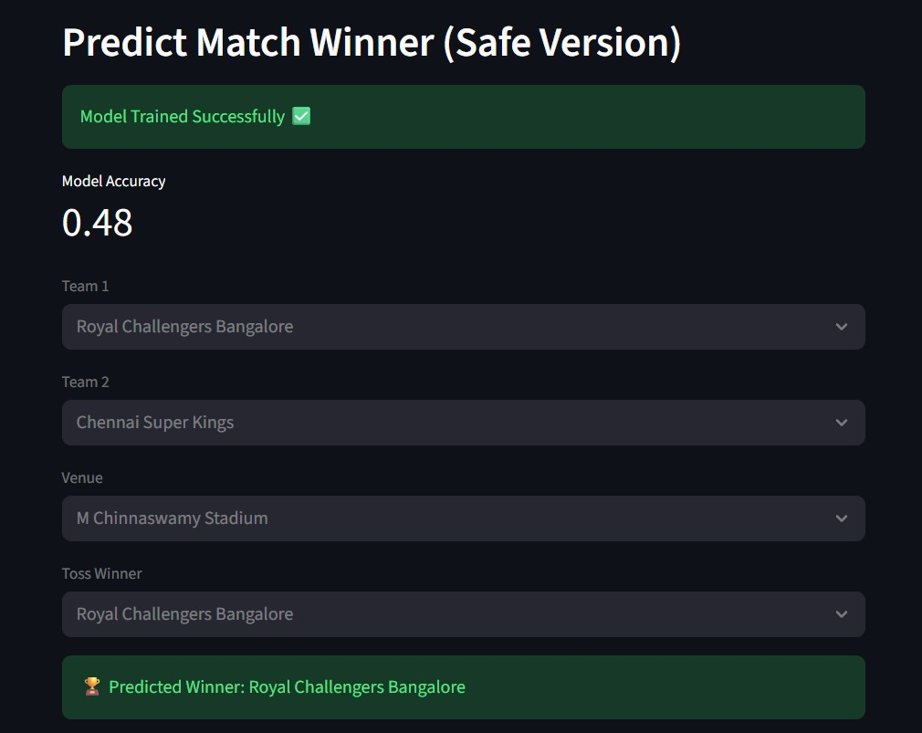
VISUALISATION
Interactive match prediction

Slide 13
FUTURE SCOPE
Add live match data for real-time predictions.
Implement advanced ML models (XGBoost, Deep Learning).
Integrate sentiment analysis from social media.
Deploy dashboard online for public access.
Add mobile-responsive UI and downloadable reports.

Slide 14
CONCLUSION
Successfully analyzed multi-season IPL data using DVA techniques.
Visualizations clearly show team dominance, season trends, and toss behavior.
ML model achieved ~60–70% accuracy in predicting match winners.
Streamlit dashboard makes analytics interactive and easy to use.
Demonstrated the power of data visualization + ML in sports analytics.

Slide 15
REFERENCES
1.Kaggle – IPL Dataset (Raw Data Source)
https://www.kaggle.com/datasets/ramjidoolla/ipl-data-set.
2.“Hands-On Machine Learning with Scikit-Learn, Keras & TensorFlow” – Aurélien Géron:
https://www.oreilly.com/library/view/hands-on-machine-learning/9781492032632/.
3.“Python for Data Analysis” – Wes McKinney
https://www.oreilly.com/library/view/python-for-data/9781491957653/
4.“Python Data Science Handbook” – Jake VanderPlas
https://jakevdp.github.io/PythonDataScienceHandbook/

Slide 16
THANK YOU
Any queries???

